Slide 1
COA Tutorial – Pipeline & Cache
31 October 2019

Slide 2
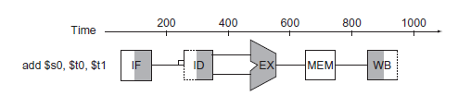
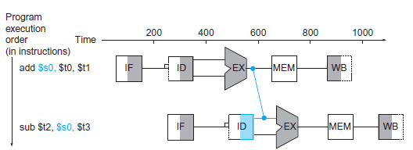
Problem 1: Data Hazard
add $s0, $t0, $t1
sub $t2, $s0, $t3
At what time instant $t2 will be updated?

Slide 3
Problem 2: Which one of these two equivalent code segments is better?
lw $t1, 0($t0)
lw $t2, 4($t0)
add $t3, $t1,$t2
sw $t3, 12($t0)
lw $t4, 8($t0)
add $t5, $t1,$t4
sw $t5, 16($t0)
lw $t1, 0($t0)
lw $t2, 4($t0)
lw $t4, 8($t0)
add $t3, $t1,$t2
sw $t3, 12($t0)
add $t5, $t1,$t4
sw $t5, 16($t0)
How many clock cycles do you save?

Slide 4
Problem 3: For each code sequence below, state whether it must stall, can avoid stalls using only forwarding, or can execute without stalling or forwarding:
lw $t0,0($t0)
add $t1,$t0,$t0
add $t1,$t0,$t0
addi $t2,$t0,#5
addi $t4,$t1,#5
addi $t1,$t0,#1
addi $t2,$t0,#2
addi $t3,$t0,#2
addi $t3,$t0,#4
addi $t5,$t0,#5

Slide 5
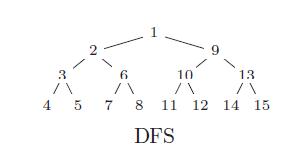
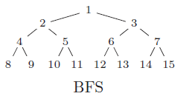
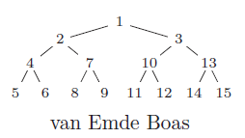
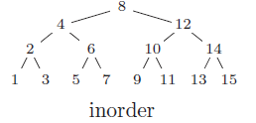
Problem 4: How to store a binary search tree so that miss-rate is reduced? Cache-Oblivious Storage
G.S. Brodal et al., Cache Oblivious Search Trees via Binary Trees of Small Height, SODA 2002, 39-48.

Slide 6
Problem 5: What are the other software techniques for reducing miss-rate
Idea: Change the data structure or code to maximize spatial and temporal locality so that cache miss-rate is reduced
Array merging
Loop-interchange
Loop fusion
Redesigning algorithms to make them cache-friendly

Slide 7
Problem 6: Mean Filtering of an Image:
How to minimize miss-rate
A cache-friendly algorithm

Slide 8
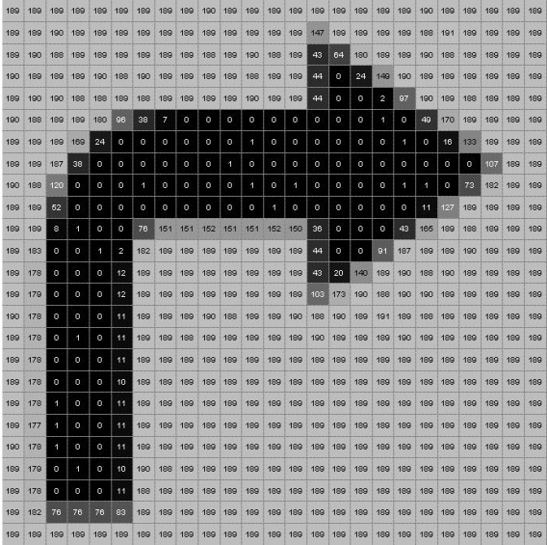
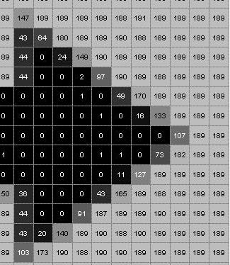
What is a Grayscale Image?
=
Quantization using 8-bits
Black = 00000000 (0)
White = 11111111 (255)

Slide 9
Mean Filtering Technique
Mean filter, also known as averaging filter or low-pass filter is a kind of smoothing spatial filter
The mean filtering is done by replacing the value of every pixel in an image by the average of the gray levels in the neighborhood defined by the filter mask
This process results in an image with reduced “sharp” transitions in gray levels

Slide 10
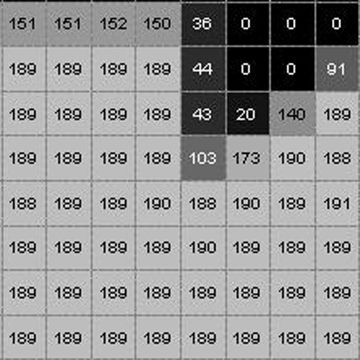
Mean Filtering Technique
The value of the pixel in the filtered image
corresponding to the centre pixel
of the window is
163
189 + 189 + 43 + 189 + 189 + 103 + 189 + 190 +188
R =
9
= 163.2222
= 163 (rounded value)

Slide 11
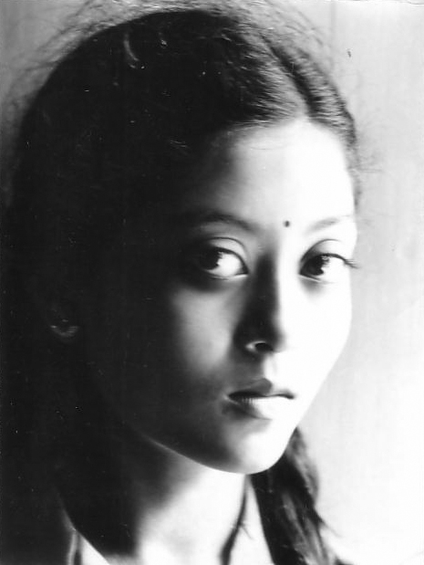


Mean Filtering Example
Original image
mean filtered image
(3 x 3 window)
mean filtered image
(5 x 5 window)

Slide 12
Problem 6: Mean Filtering of an Image:
How to minimize miss-rate
Solution: Run the filtering window following a diagonalized snake-sweep

